Slide 1
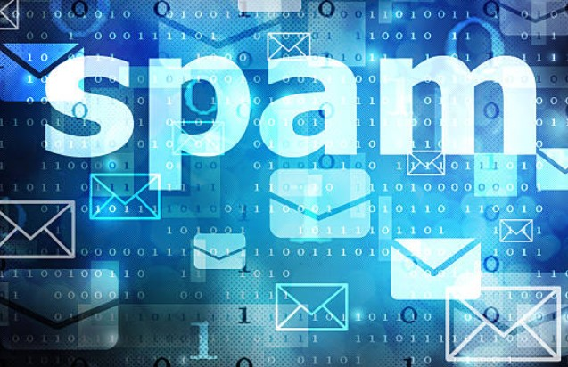
SMS
SPAM
DETECTION
TEAM MEMBERS
R.DhEEPTHA
S.AARTHI
S.APSARA

Slide 2

ABSTRACT
SPAM MESSAGES CAN BE REFERRED AS UNSOLICITED BULK MESSAGES. THESE MESSAGES ARE USED TO ADVERTISE PRODUCTS AND SERVICES FOR PHISHING PURPOSES OR TO LEAD RECIPIENTS TO MALICIOUS SITES WITH UNETHICAL INTENTIONS. ALTHOUGH NUMEROUS TECHNIQUES TO BLOCK SPAM MESSAGES HAVE BEEN DEVELOPED, WE STILL RECEIVE THEM QUITE OFTEN. THE REASON BEHIND THIS IS , THE ABILITY OF THE SPAMMERS TO MANIPULATE THE FILTERS. THEREFORE WE PRESENT A METHOD BASED ON NATURAL LANGUAGE PROCESSING (NLP) FOR THE FILTRATION OF SPAM MESSAGES IN ORDER TO ENHANCE SECURITY. THE TECHNIQUE PRESENTED IN THIS PAPER IS A STEPWISE APPROACH WHICH BLOCKS SPAM MESSAGE’S BASED ON THE SENDER AS WELL AS THE CONTENT OF THE MESSAGE.

Slide 3

STEPS INVOLVED
1.DATA COLLECTION
THE SMS SPAM DATASET IS COLLECTED FROM KAGGLE
2.TEXT PREPROCESSING
IMPORTING THE DATASET
REMOVE PUNCTUATIONS, NUMBERS
CONVERT EACH WORD INTO ITS LOWER CASE,
APPLY STEMMING, SPLITTING DATA INTO TRAINING AND TEST SET.
3.MODEL BUILDING
IMPORTING THE MODEL , BUILDING LIBRARIES , INITIALIZING THE MODEL , ADDING INPUT LAYER , HIDDEN LAYER AND OUTPUT LAYER , CONFIGURING THE LEARNING PROCESS , TRAINING AND TESTING THE MODEL , OPTIMIZE THE MODEL , AND SAVE THE MODEL,PREDICTIONS
4.APPLICATION BUILDING
CREATING A HTML FILE AND BUILDING A PYTHON CODE.

Slide 4
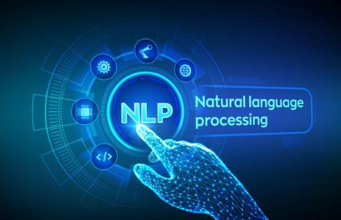
TECHNIQUES IMPLEMENTED:
Deep learning-NLP(Natural language Processing)
- python
NLP allows combining of deep learning techniques with text messages that will predict if the message is a HAM or SPAM after analyzing the text through the dataset.
Spam messages may cause a major threat to us.
Thus, using NLP techniques we can analyze and detect the type of messages .
This paper represents a Deep Learning model to detect whether the message is a spam message with an accuracy of 99.8%.
.
APP BUILDING WEB DEVELOPMENT
HTML
CSS

Slide 5

1.DATA COLLECTION
*THE SPAM DATA SET IS COLLECTED
FROM KAGGLE.
*DATASET WITH .TSV EXTENSION
IS USED.
*DATASET IS SPLITTED INTO TRAIN AND TEST

Slide 6

2. TEXT
PREPROCESSING
*Import the dataset, using libraries like pandas and numpy .
*Remove the punctuations and numbers
*Remove null values.
*Remove the regular expressions.
*Convert each word into its lower case.
*Apply stemming(to remove stop words)
*split the data to test and train

Slide 7
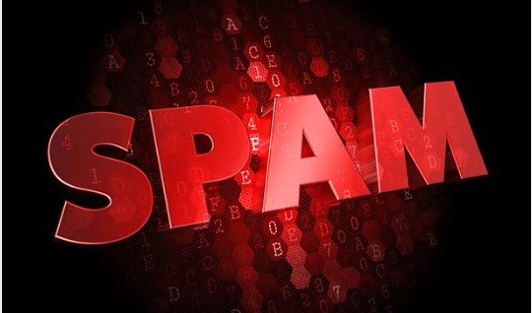
3.MODEL BUILDING
*import model & build libraries
Initialize the model ,
*Add input layer , hidden layer and output layer.
*Configure the learning process ,
*Train and test the model ,
*Optimize the model.
* Predict the model by giving Inputs.
*Save the model.
*Accuracy of our model is 99.8%

Slide 8

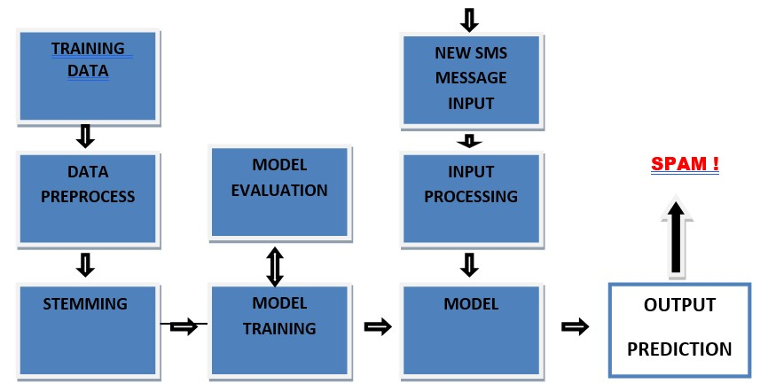
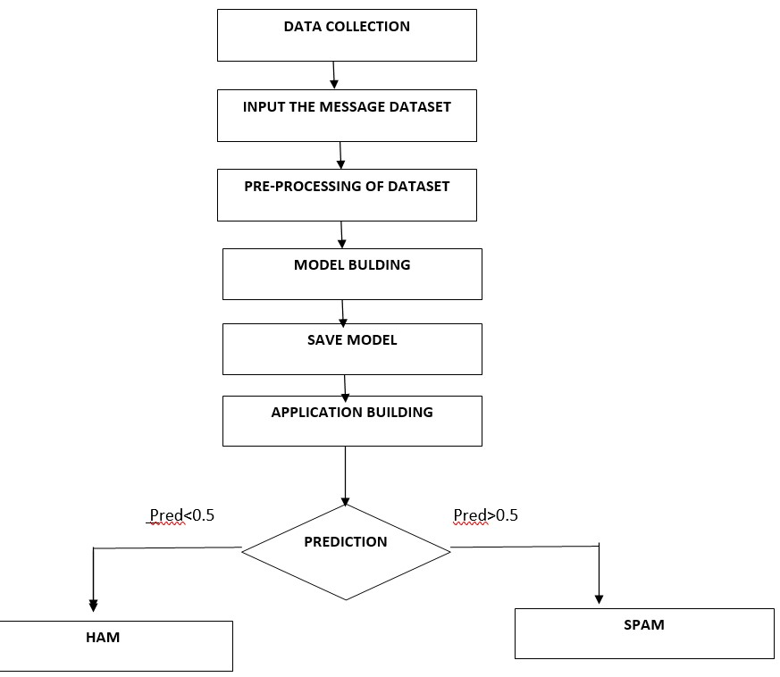
Block diagram

Slide 9
4.APPLICATION BUILDING
*Creating a HTML file & CSS FILE
*Building a python code Using FLASK.
APPLICATION:
Spreading malicious links can be avoided.
Bulk messages used to spread used for spreading malware or advertising to direct user’s site can be prevented.

Slide 10
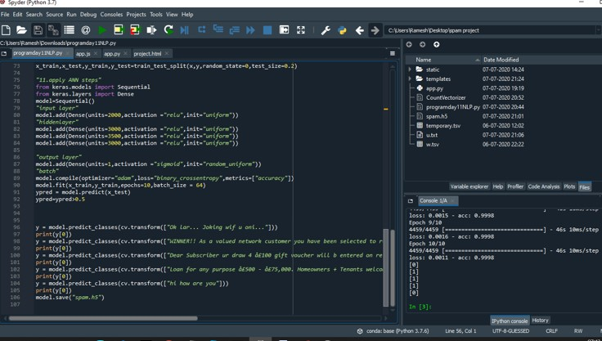
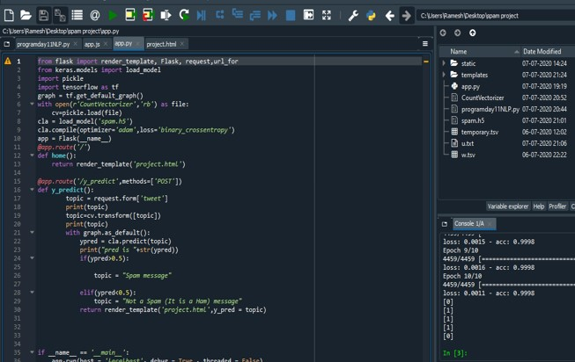

Slide 11
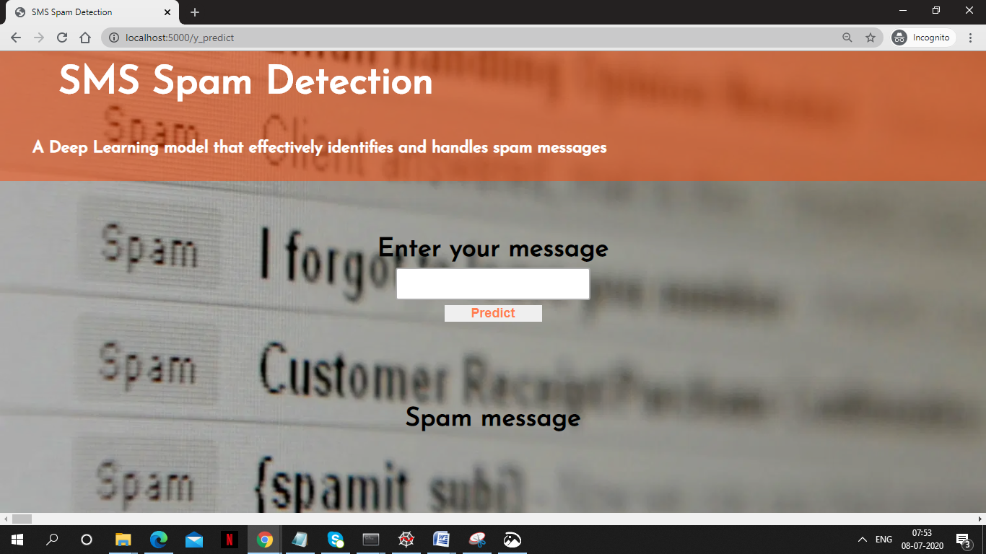

Slide 12
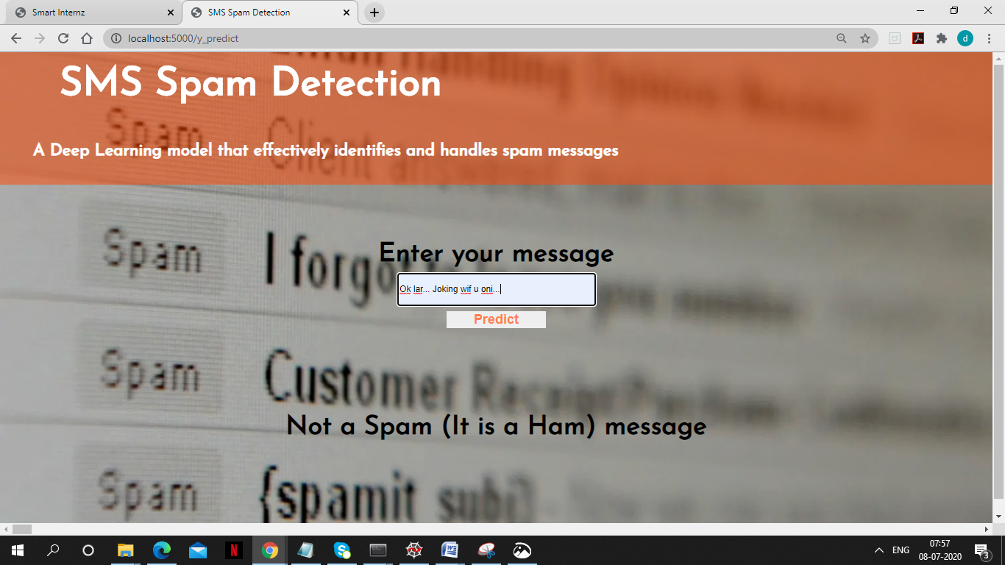

Slide 13

RESULT
* The model gave an accuracy of 99.8% which is a good measure.
* Deep Learning and predicts the entered SPAM message texts

Slide 14

This Photo by Unknown Author is licensed under CC BY-NC-ND

